Slide 1

Notes:
Welcome everyone, and thank you for joining today’s workshop on Navigating the Early Childhood Education Job Market. This session is designed to help you transition from being a student to becoming a confident, competitive ECE professional. We’re going to talk about where the jobs are, how to position yourself effectively, and how to stand out during the application and interview process. The goal is for you to leave today with clarity, direction, and a concrete action plan. Let’s get started on building your path into the ECE workforce.

Slide 2

Notes:
The Early Childhood Education field is currently experiencing high demand across the country. Many centers are facing staffing shortages, which means qualified candidates like you have real leverage in this market. This is not an oversaturated field — it’s a growth sector with expanding opportunities in both private and public settings. Because of this demand, employers are actively seeking trained, prepared educators.
What this means for you is that you are entering the workforce at a strong time. Centers are not just looking to fill positions — they are looking for reliable, credentialed professionals who understand child development and classroom management. When demand is high, candidates have more room to ask questions, compare offers, and seek supportive work environments. The key is understanding how to position yourself strategically so you can take full advantage of the opportunities available to you.

Slide 3
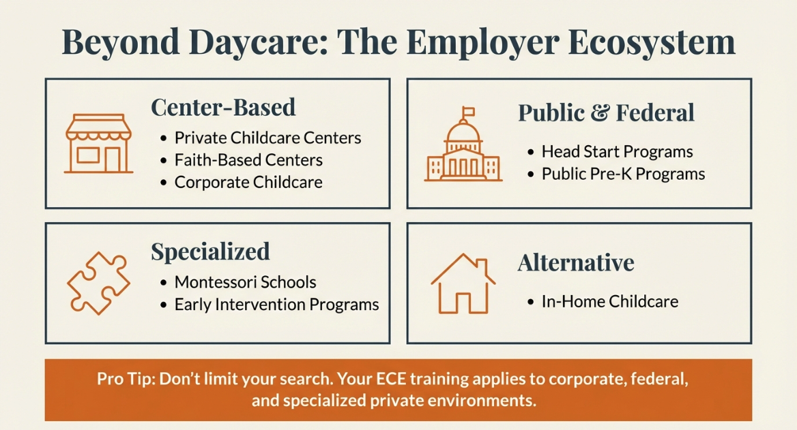
Notes:
When we talk about the Early Childhood Education employer ecosystem, we’re referring to the full range of environments where your training and credentials can be applied. The most common setting is center-based childcare, including private daycare centers and preschool programs serving infants through pre-kindergarten. You can typically find these openings on platforms like Indeed, Google Jobs, and by visiting individual center websites directly. Many centers also post openings on social media pages or community boards.
Public and federally funded programs, such as Head Start and public Pre-K, are another major part of the ecosystem. These positions are often posted on local school district websites, state Department of Education websites, or directly on the Head Start locator site. These roles may have more defined qualification requirements, so it’s important to carefully review job descriptions for credential, background clearance, and certification expectations.
Specialized schools, including Montessori programs and early intervention centers, often list openings on their individual school websites or through education-specific job boards. When exploring these roles, research the teaching philosophy of the organization so you understand what additional training or certifications may be preferred.
Alternative options, such as in-home childcare or nanny positions, are frequently posted on platforms like Care.com or through local parent networks. For these roles, qualifications may focus more on experience, references, and certifications like CPR and First Aid.
To determine qualifications for any role, always read the full job posting carefully and cross-reference it with your state’s licensing or Department of Education website if needed. Understanding both where to look and what employers require will help you target positions that align with your credentials and career goals.

Slide 4
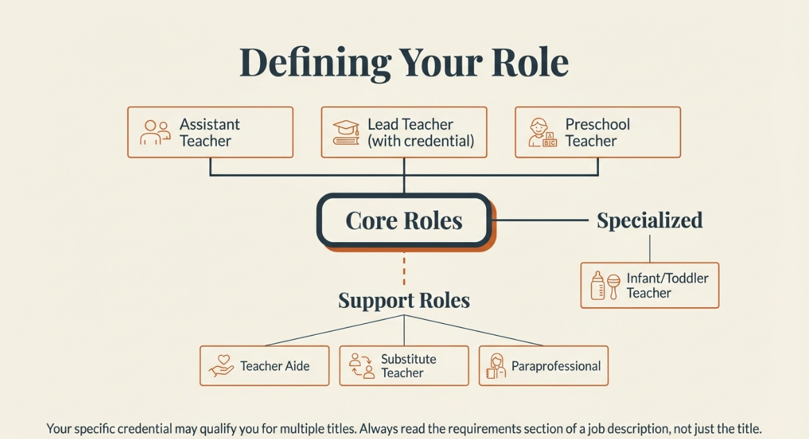
Notes:
When entering the Early Childhood Education field, it’s important to clearly understand the different roles available and how they align with your credentials and experience. An Assistant Teacher typically supports the Lead Teacher in implementing lesson plans, supervising children, and maintaining classroom structure. This role is often ideal for entry-level professionals who are gaining hands-on experience while developing classroom management skills.
A Lead Teacher carries primary responsibility for lesson planning, classroom instruction, child assessments, and parent communication. This position usually requires a credential such as a CDA or formal ECE certification, and sometimes additional experience.
A Preschool Teacher typically works with children ages three to five and focuses heavily on school readiness, structured learning activities, and developmental milestones. These roles often emphasize curriculum planning and preparing children for kindergarten.
An Infant or Toddler Teacher works with younger age groups and must understand early developmental stages, including sensory learning, motor skill development, and emotional attachment. These roles require patience, attentiveness, and strong knowledge of early brain development.
A Teacher Aide supports classroom operations but may not carry full instructional responsibilities. This role often focuses on assisting with supervision, classroom organization, and activity support.
Substitute Teachers provide temporary classroom coverage and must be adaptable, flexible, and prepared to step into different environments with short notice.
Understanding the differences between these roles helps you apply strategically. Before submitting applications, review job descriptions carefully to ensure your qualifications match the responsibilities outlined. When you clearly understand your role, you can confidently present yourself as the right fit for that specific position.

Slide 5
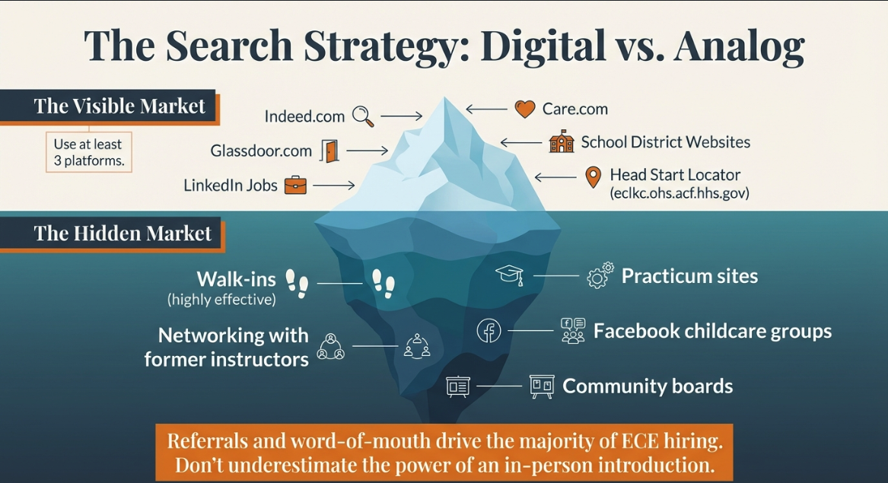
Notes:
This slide represents your job search strategy as an iceberg. What you see above the surface are the most visible and commonly used job search platforms — websites like Indeed, Care.com, Glassdoor, LinkedIn, school district websites, and the Head Start Locator. These are important tools, and you should absolutely be using them consistently. They allow you to see posted openings, compare qualifications, and apply directly. However, what many candidates don’t realize is that these visible platforms represent only part of the opportunity landscape.
Below the surface is what we call the hidden job market — and in Early Childhood Education, this is extremely powerful. Many childcare centers rely heavily on referrals, word of mouth, and internal recommendations rather than formal job postings. Walking into a center with a professional resume, reaching out to your practicum site, networking with former instructors or classmates, and joining local Facebook childcare groups can open doors that never appear online. Community boards, church bulletins, and parent networks are also common hiring channels in this field.
In ECE especially, trust matters. Directors often prefer to hire someone who comes recommended or who has shown initiative by introducing themselves professionally. If you rely only on online applications, you may miss a large percentage of available opportunities. A strong job search strategy means combining both the visible and hidden market to maximize your chances of securing the right position.

Slide 6
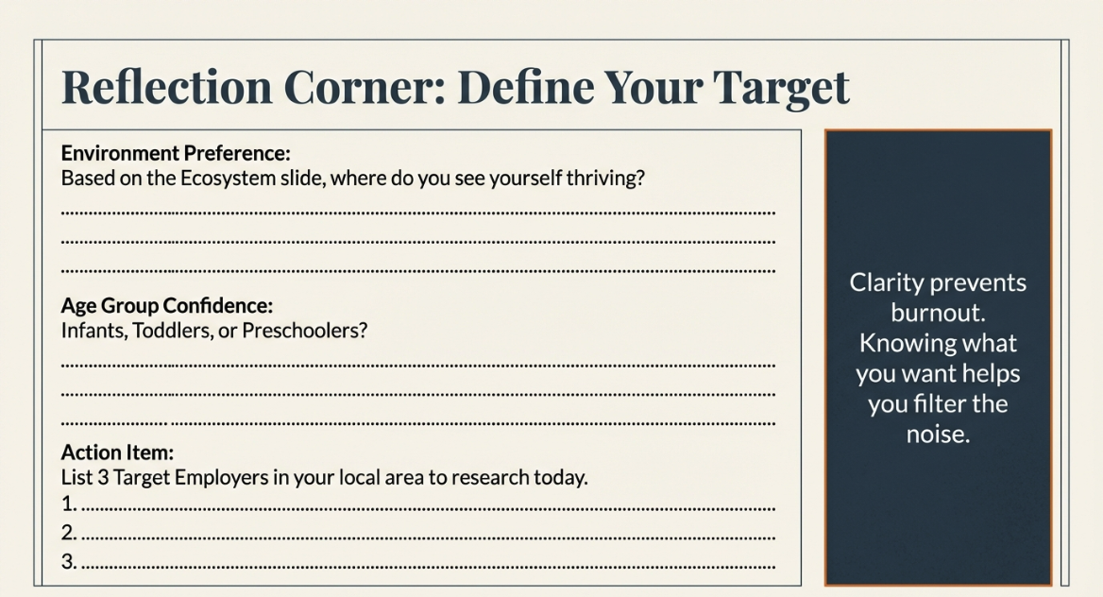
Notes:
This is our reflection corner, and this is where your job search becomes personal and intentional. Based on the employer ecosystem we just discussed, where do you honestly see yourself thriving? Think about your personality, your strengths, your patience level, and the type of environment where you do your best work. Choosing the right setting is important because your work environment directly impacts your job satisfaction and long-term success.
Next, consider the age group you feel most connected to — infants, toddlers, or preschool-aged children. Each age group requires different skills, energy levels, and developmental knowledge. Being clear about your preferred age group helps you target positions more strategically instead of applying randomly.
Finally, I want you to identify three specific employers you can research today. Not just general job boards — actual centers, school districts, or programs by name. When you define your target, you shift from “looking for a job” to “pursuing the right opportunity.” Intentional job searching increases confidence, improves interview performance, and helps you align your career with your strengths and long-term goals.

Slide 7
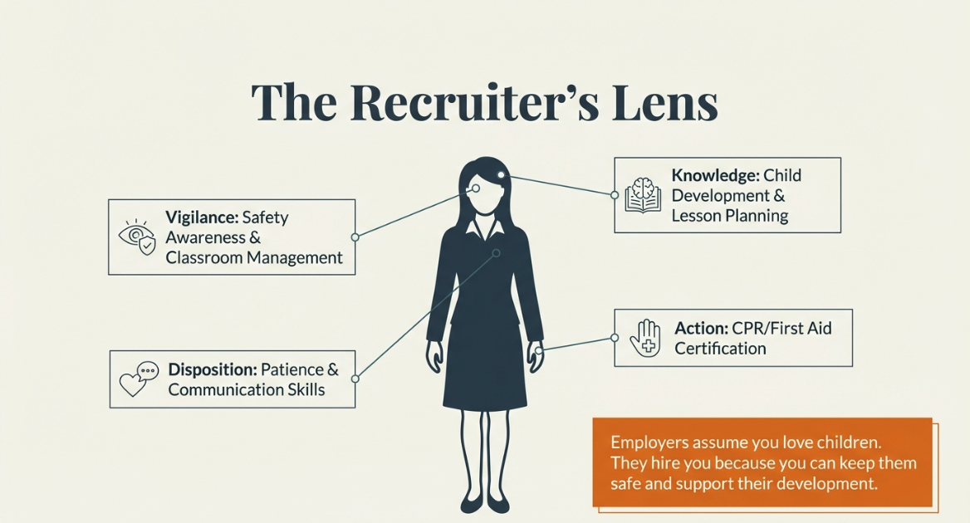
Notes:
When you apply for an ECE position, it’s important to understand how recruiters and center directors are evaluating you. They are not just asking, ‘Do you like working with children?’ They are viewing you through a professional lens focused on vigilance, safety, and classroom management. Employers want to know that you can actively supervise children, anticipate potential risks, and maintain a structured, safe learning environment at all times.
Safety is always the top priority in early childhood settings. This is where certifications like CPR and First Aid become critical — they demonstrate preparedness and responsibility. Recruiters are also evaluating your knowledge of child development and whether you understand age-appropriate practices.
Disposition matters just as much as skill. Directors look for patience, professionalism, reliability, and the ability to communicate effectively with parents and coworkers. Finally, they look at action — not just what you say you can do, but examples of how you’ve managed behavior, supported learning, or handled challenging situations. When you understand the recruiter’s lens, you can frame your resume and interview responses to directly address what employers are truly looking for.

Slide 8
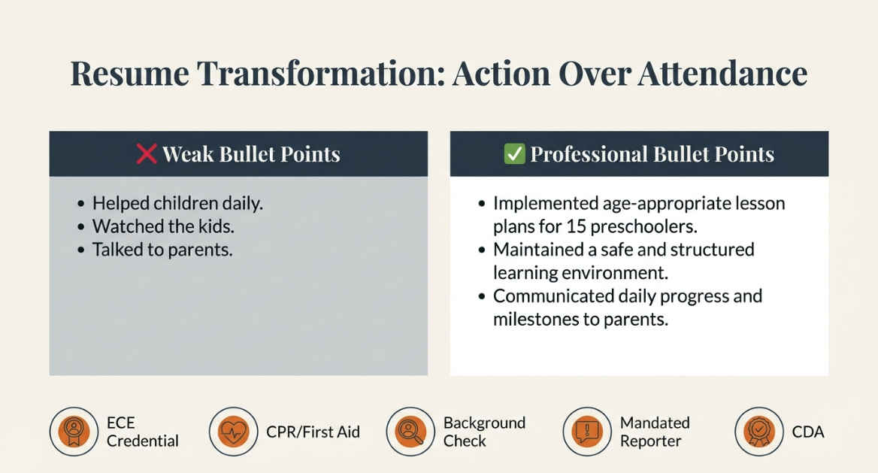
Notes:
This slide is about transforming your resume from basic to professional. Many students unintentionally describe their experience in passive terms like ‘helped children,’ ‘watched the kids,’ or ‘talked to parents.’ While those statements may be true, they do not reflect the level of responsibility or professionalism employers are looking for. Recruiters want to see action, impact, and accountability — not just attendance.
Instead of saying ‘helped children,’ you might say ‘implemented age-appropriate lesson plans for 15 preschoolers.’ Rather than ‘watched the kids,’ you could say ‘maintained a safe and structured learning environment in compliance with state licensing regulations.’ And instead of ‘talked to parents,’ you can write ‘communicated daily progress, behavioral updates, and developmental milestones to parents.’
These shifts may seem small, but they dramatically elevate how you are perceived. Your resume should also clearly list professional credentials such as CPR and First Aid certification, background clearance, mandated reporter training, and any ECE credentials earned. These are not minor details — they signal readiness, compliance, and professionalism.
Your resume is often your first impression before you ever step into an interview. When it reflects action, responsibility, and certification, it positions you not as someone who ‘likes children,’ but as a trained Early Childhood Education professional.

Slide 9
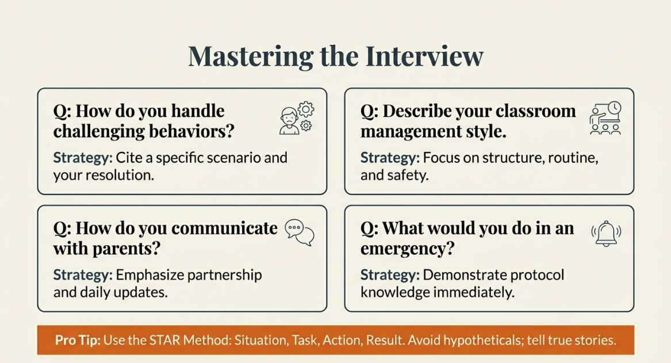
Notes:
This slide is about mastering the interview by being intentional and strategic in how you answer questions. One of the most common questions you’ll hear is, ‘How do you handle challenging behaviors?’ When answering this, don’t speak in general terms. Cite a specific scenario, explain what the challenge was, what action you took, and what the outcome was. Employers want to hear real examples that show emotional control and problem-solving.
Another common question is, ‘Describe your classroom management style.’ Your answer should focus on structure, consistency, routine, and safety. Directors want to know that your classroom is predictable, organized, and supportive — not chaotic.
When asked, ‘How do you communicate with parents?’ emphasize partnership. Talk about daily updates, progress reports, and proactive communication. Show that you understand parents are partners in a child’s development, not just recipients of information.
If asked, ‘What would you do in an emergency?’ demonstrate immediate knowledge of protocol. Mention supervision, securing children, following center procedures, and utilizing CPR or First Aid training if necessary. This question is about safety and composure under pressure.
Throughout all of your responses, use the STAR Method — Situation, Task, Action, and Result. Tell true stories from your practicum, volunteer work, or prior experience. Structured, real examples make you sound prepared, confident, and professional.

Slide 10
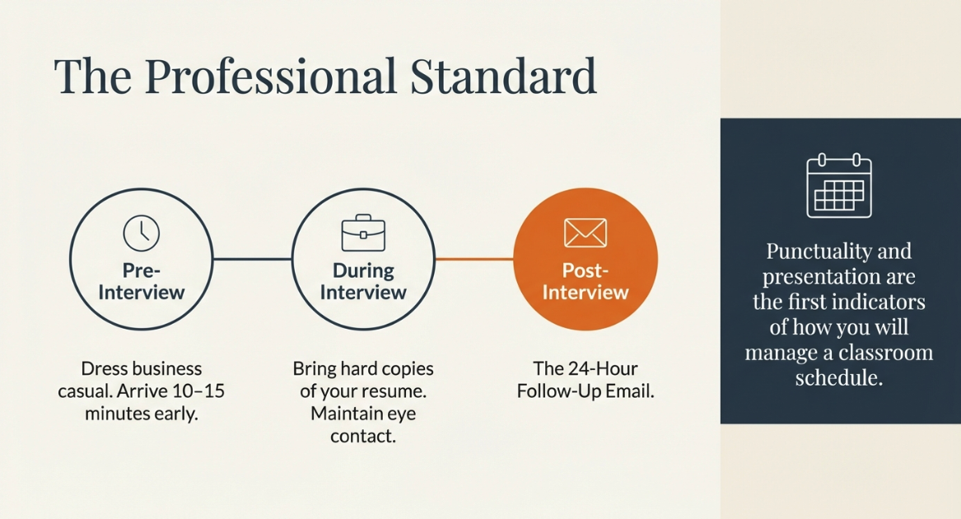
Notes:
This slide focuses on professional standards before, during, and after the interview. Professionalism doesn’t start when you walk into the building — it starts the moment you apply. Before the interview, research the center or program thoroughly. Understand their philosophy, age groups served, and any unique programs they offer. Prepare copies of your resume, organize your certifications such as CPR and First Aid, and plan professional attire that reflects the field — clean, business casual, and appropriate for working with children.
During the interview, arrive 10 to 15 minutes early and bring a calm, confident presence. Maintain eye contact, listen carefully to each question, and answer using structured examples. Speak clearly about safety, classroom management, and child development knowledge. Remember that directors are evaluating not only your answers, but your professionalism, communication skills, and overall disposition.
After the interview, your professionalism continues. Send a follow-up email within 24 hours thanking the interviewer for their time and reaffirming your interest in the position. This small step sets you apart from many candidates and reinforces your professionalism. Strong pre-interview preparation, confident performance during the interview, and thoughtful follow-up afterward demonstrate that you take your career seriously and understand workplace expectations.

Slide 11
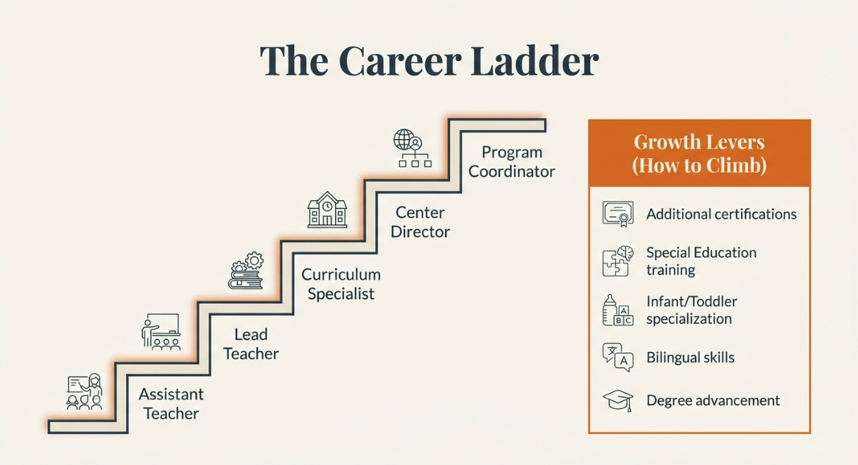
Notes:
This slide highlights something very important — Early Childhood Education is not just a job, it’s a structured career pathway. Many professionals begin as Assistant Teachers, where they gain foundational classroom experience and learn daily operations. With experience, strong performance, and the right credentials, they can advance to Lead Teacher roles, taking responsibility for curriculum implementation, child assessments, and parent communication.
From there, growth can continue into positions such as Curriculum Specialist, where you support instructional quality across multiple classrooms. With leadership development and operational knowledge, you may move into Center Director roles, overseeing staff management, compliance, budgeting, and licensing standards. At the highest levels, roles such as Program Coordinator, Education Manager, or regional leadership positions oversee multiple sites or specialized early learning initiatives.
Climbing this ladder requires intentional professional development. Additional certifications such as the Child Development Associate (CDA), state-specific ECE credentials, or Director Credential programs significantly increase advancement opportunities. Specialized certifications in Infant and Toddler Development, Special Education, Trauma-Informed Care, Positive Behavior Support, or Early Childhood Administration can also strengthen your qualifications.
Health and safety certifications beyond CPR and First Aid — such as Medication Administration Training (MAT), Child Abuse Prevention Training, and Emergency Preparedness certifications — can make you more competitive. Bilingual certification or documented language proficiency is also highly valuable in diverse communities.
Finally, degree advancement — earning an Associate’s, Bachelor’s, or even a Master’s degree in Early Childhood Education or Child Development — can open doors to higher-paying leadership and administrative roles. The key message is this: your first role is your starting point, not your destination. With continued education, certifications, and professional growth, you can intentionally move up the career ladder and expand both your influence and earning potential in the ECE field.

Slide 12
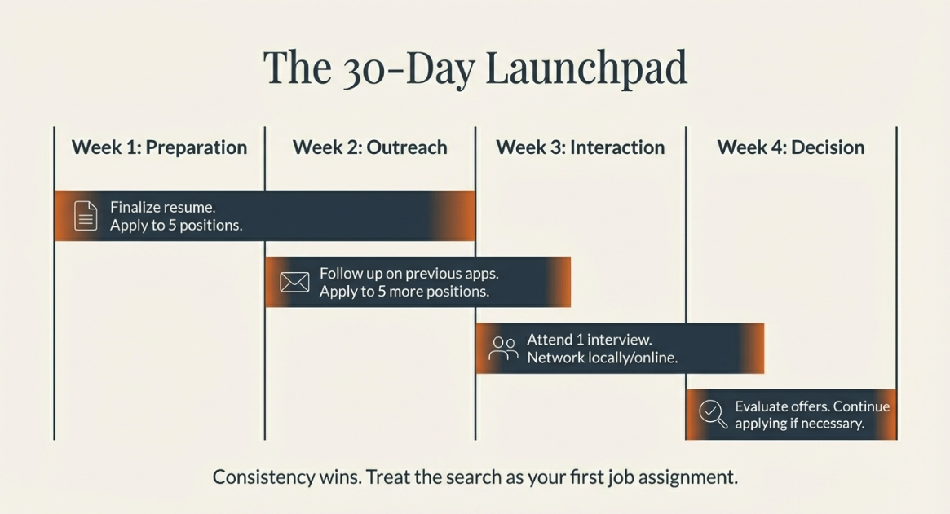
Notes:
This slide outlines your 30-Day Launch Pad — a structured plan designed to move you from preparation to employment with intention and consistency.
Week 1 is focused on preparation. This means finalizing your resume, organizing your certifications, confirming your references, and submitting at least five targeted applications. The goal this week is quality and readiness, not rushing. Take time to tailor your resume to each position instead of sending the same version everywhere. Make sure your certifications such as CPR, First Aid, and background clearance are accessible and ready to provide if requested. Strong preparation sets the tone for everything that follows.
Week 2 is about outreach. Follow up on the applications you submitted in Week 1 with a professional email or phone call, and apply to five additional positions. Following up shows initiative and separates you from passive applicants. Keep track of where you applied and when so you can follow up professionally and on time. Outreach also includes introducing yourself to centers in person or connecting through LinkedIn or community groups. Visibility increases opportunity.
Week 3 focuses on interaction. This is when you aim to attend at least one interview and actively network — whether that’s connecting with local ECE professionals, visiting centers, or engaging in online childcare groups. Interviews and networking build momentum and visibility. After each interview, reflect on what went well and where you can improve. Each interaction strengthens your confidence and sharpens your communication skills.
Week 4 is dedicated to decision-making. Evaluate any offers you receive carefully, considering work environment, leadership style, growth potential, and support systems. If you have not yet secured an offer, continue applying and refining your approach. Compare roles not just based on pay, but on long-term professional development. Remember, the goal is not just employment — it’s the right fit for your career growth.
Consistency wins. Treat your job search like your first professional assignment — structured, disciplined, and goal-oriented. When you approach your search with this level of commitment, you move from hoping for opportunities to actively creating them.

Slide 13
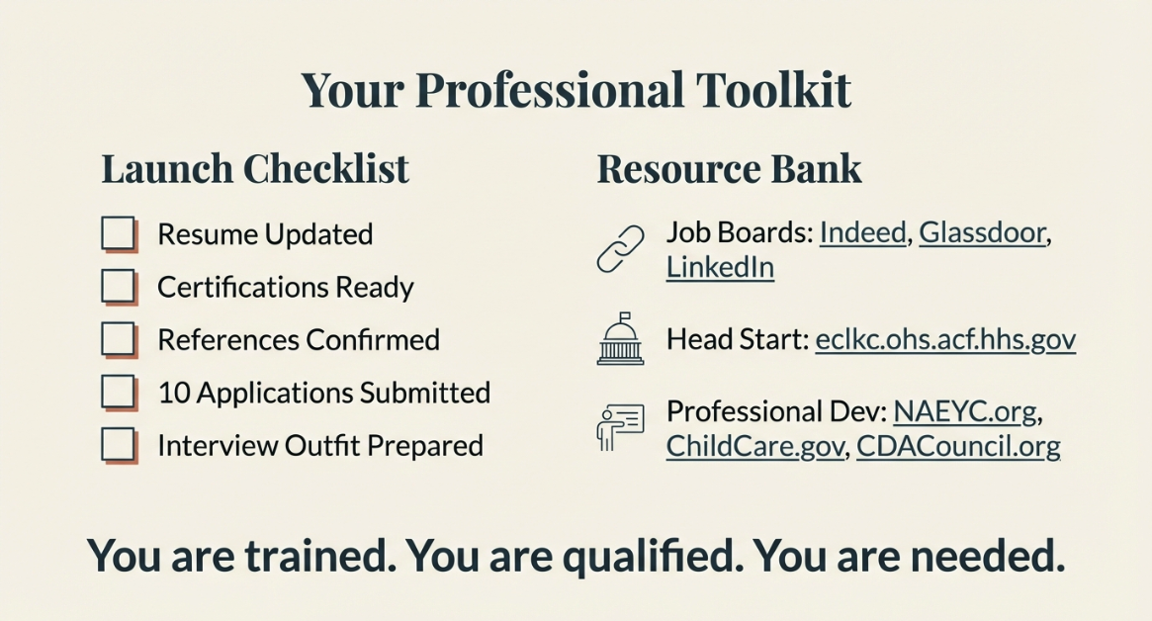
Notes:
This final slide represents your professional toolkit — everything you need to move forward with confidence. First, we have your launch checklist: your resume is updated, your certifications are ready, your references are confirmed, at least 10 applications have been submitted, and your interview outfit is prepared. These are not small details — they are professional standards. When these boxes are checked, you are positioned as a serious candidate.
Next is your resource bank. Continue using job boards like Indeed and LinkedIn, but also explore the Head Start locator and local school district websites. For ongoing professional development, organizations like NAEYC, ChildCare.gov, and the CDA Council provide valuable training, industry updates, and certification guidance. Staying connected to professional organizations keeps you competitive and informed.
Remember this: you are trained, you are qualified, and you are needed. The Early Childhood Education field depends on prepared professionals who understand safety, development, and structured learning. Approach your job search with confidence and consistency. Your toolkit is complete — now it’s time to use it.”
As you leave today, remember this — you are not just applying for a job, you are stepping into a profession that shapes lives at the most critical stage of development. The children you will teach are learning how to think, communicate, regulate emotions, and build confidence — and you will play a direct role in that foundation. This field needs prepared, vigilant, compassionate professionals, and you are equipped to meet that need. Approach your job search with discipline, professionalism, and belief in your training. The opportunity is there — now it’s your move.

